Slide 1
New to Year 3
Information Session for Parents and Carers
Tuesday 18th September
www.morley.cambs.sch.uk
Please sign in on the class sheet.
Who are we?
Turquoise Class: Jo Proctor Mel Bowler
Topaz Class: Josh Hanson
Teaching Assistants: Haleh Foroughi

Slide 2
Topics
•Roald Dahl
•Volcanoes
•Ancient civilizations
•Ancient Egyptians
•Where the Wild Things are
•The Romans

Slide 3
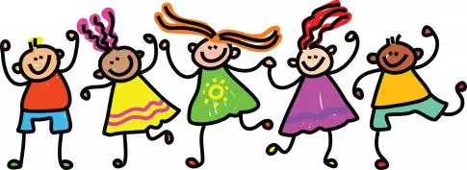
New to KS2
We’ll go swimming in the summer term. More information will be provided via the school website and a letter closer to the time.
French will be taught on Thursdays by a specialist teacher - Ms Jarry.

Slide 4
Year 3 Essentials: Every Day
Message Book in class for home/school communication (pick ups, clubs, etc).
Water bottles can be brought into school. Children can fill them in the morning on arrival, and take home to clean at the end of the day.
Clothing suitable for the weather: jacket/coat (hats/gloves in winter) and sensible shoes for outdoor playtimes.
Book bag: Reading Record book, class reading book

Slide 5
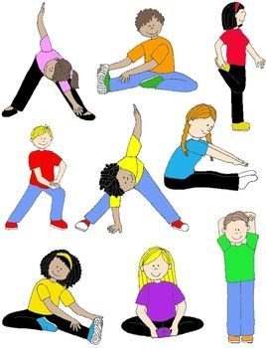
Year 3 Essentials: PE kits
Our PE days are:
Monday (indoor) and Thursday (outdoor) for Turquoise
Tuesday (Outdoor) and Thursday (indoor) for Topaz.
It is often easier for PE kits to remain in school throughout the half term.
Children need to wear shorts and a T-shirt and as the weather gets cooler jogging trousers / legging and a sweatshirt.
Long hair needs to be tied back and earrings should not be worn on PE days or will have to be taped at school.
Trainers or plimsolls are needed on outdoor PE days.

Slide 6
Year 3: Healthy Eating
In line with the school’s healthy eating policy please ensure early morning snacks are non-sugary such as fruit or vegetables.
Milk can be arranged with the office on a termly basis.
If you’d like to bring in something to share on your child’s birthday, fruit would be great or even better a book to add to the class library.

Slide 7
Year 3 Home learning: Reading
•We encourage parents to read regularly with their children and to record this in their child’s reading diary. Children may also record their own independent reading in their reading diary.
•Some children have colour banded books and others are free readers. A choice of home / class reading books are found in the class libraries.
•Each week the classes will get time to explore and enjoy the school library and its numerous books. Children can choose 1 book to borrow from the library and this book can be returned the following week or can be kept for a fortnight. Please keep library book in book bags to help prevent them being mislaid.

Slide 8
Home Learning: Homework book
Year 3 & 4 words are stuck in the homework book. Children need to be able to read and spell these words by the end of Year 4.
Children should continue to consolidate the 2x, 5x and 10x and develop fluency in the 3x, 4x and 8x.

Slide 9
Home Learning: Weekly Homework
In Y3 we use the Pen Pals scheme for handwriting. Children will receive a practice sheet most weeks, which will be stuck in their homework book.
We are following a scheme called No-Nonsense Spelling. Most weeks we’ll send home some spellings to practise material covered in lessons, although there won’t be a formal spelling test.
In addition, there may be a piece of work to consolidate learning in either maths or English. Alternatively a long term topic-based project may be given.
Homework will be handed out on a Thursday and should be handed in by Tuesday morning please.

Slide 10
Thank you for all your support!
Could you volunteer to help regularly or at one-off events?
If you feel you have expertise in any of the topics we’re covering, we’d welcome your input.

Slide 11
Thanks for coming
Any questions?
Please remember to take a sheet.
The information covered this afternoon is also available on the school website:
www.morley.cambs.sch.uk

