Slide 1
Welcome to Year 5
Information Session for Parents and Carers
Tuesday 26th September
www.morley.cambs.sch.uk
In Year 5 we are:
Amethyst Class: Ms Griffiths
Indigo Class: Ms Hutchinson
Both classes are covered for PPA by Ms Simpson
Teaching Assistant Team: Ms Dennis, Mr Gill and Ms Covington

Slide 2
Welcome to Year 5
Topics this year:
Autumn 1 - British Civil Rights, Space
Autumn 2 - Space, Shakespeare
Spring 1 - Shakespeare, Vikings
Spring 2 - Vikings
Summer 1 - Victorian Cambridge
Summer 2 - Rainforest
Financial assistance may be available for trips/visits, please speak to the class teacher in the first instance.

Slide 3
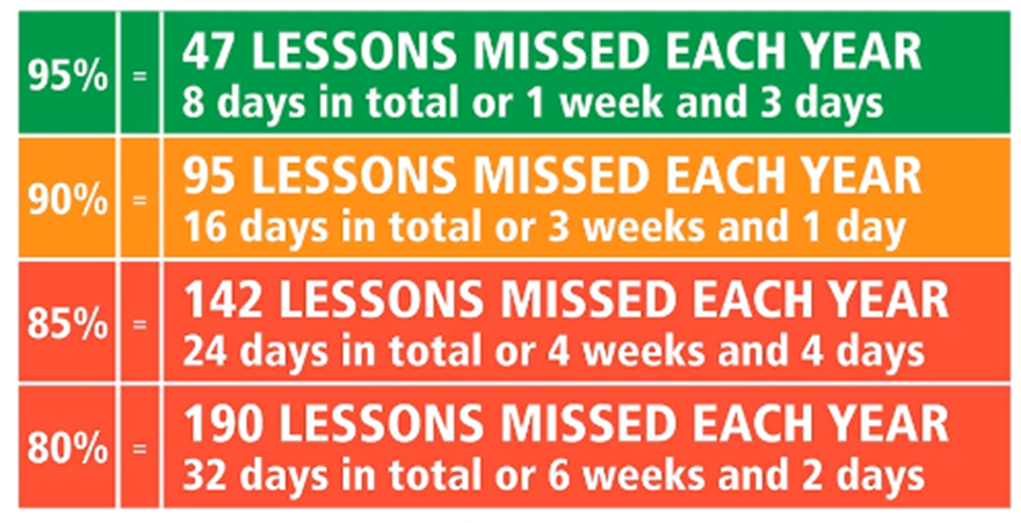
Every Day Attendance
Children arrive at school at 8:40, ready to come
into school at 8:45 when the gates will be closed.
Teachers take the register at 8:45.
Punctual arrival is important, as teaching starts promptly - aim for 100% attendance!
Did you know…?

Slide 4
Every Day Attendance
Please inform the School Office if your child is unwell on the morning of the illness (email or phone message).
Any medication must be in the original packaging, in a named bag and handed in to the Office - there is a form to complete.
48 hours is needed before returning to school following diarrhoea and/or vomiting.
Term time absence, other than illness, is only authorised by the Head Teacher in exceptional circumstances - see Attendance Policy on the school website.

Slide 5
Asthma & Allergies
Please do not send in nuts or nut products (including Nutella type spreads) as part of snacks or packed lunches - we have a number of children and staff with life-threatening allergies.
Inhalers & spacers should be named and in a bag (for hygiene reasons). They are kept in a central place in class. An asthma card must be completed.
Epi-pens should be in date, in a named container and handed to the School Office with the protocol.
It is the parent/carer’s responsibility to ensure inhalers and auto-injectors are in date
and in school.
See our Medicines in School policy on the school website

Slide 6
Year 5 Essentials: Every Day
Water bottles should be brought into school
daily. Children can refill them in school as
needed and must take them home to clean
at the end of the day - water only please,
no squash, juice or fizzy drinks.
Clothing suitable for the weather and activities:
coat (hats & gloves in winter) and sensible shoes for outdoor playtimes (especially for Forest School).
Reading book & Reading Record DAILY!

Slide 7
Year 5 Essentials: Every Day
Please do not bring in:
Pencil cases - all stationery is provided.
Toys, including collector cards.
Jewellery (small studs only for pierced ears).
KS2 -no sugary snacks, fizzy drinks or sweets - healthier snacks for break time please .

Slide 8
Children in KS2 can arrive in PE kits and
change after PE.
PE Kit should be named, in a bag, in school and taken home to wash!
Our PE days are on: Monday and Tuesday
Children will need to arrive in:
- A white t-shirt (dark blue jumper in cold weather)
- Black/dark blue shorts (joggers for cold weather)
- Trainers or plimsolls (check size regularly)
They must bring usual school clothes to change
into after their lesson.
Long hair must be tied back, so come prepared with a hair band in kits. Jewellery should not be worn in PE sessions. Stud earrings will either need to be taken out or taped up for PE lessons. It is the children’s responsibility to organise this.
Notes:
KS2 page – KS1 delete

Slide 9
Year 5 General
Letters and notices:
Most information will be via ParentMail.
Please sign up if you have not already done so.
Check the weekly newsletter for key information and the class page on the website for general year group information.
Birthdays:
No sweets please

Slide 10
Year 5 Essentials: Helping at Home
At Morley Memorial Primary School we see home learning as an opportunity for children to practise skills, develop independence, consolidate and reinforce learning and as an avenue for children to pursue interests and be creative.
Home learning also provides unique opportunities for family learning and collaboration.
Please support your child to complete tasks in their own way in order that they develop our positive learning dispositions at home and at school:
Motivation Curiosity Courage
Collaboration Resilience Reflection

Slide 11
Year 5 Essentials: Helping at Home
We believe every child has the right to a childhood, opportunities to play and explore and time to develop their talents and interests. We therefore try to keep home learning to a level which allows an appropriate balance.
We will assign home learning where there will be benefits to children’s learning rather than to fulfill an expectation of a particular number of hours a week. This approach we believe promotes effective home learning with activities which are meaningful and increase children’s engagement and achievement.
Having said this, frequent (daily) reading and practice of number facts is crucial if children are to make good progress and develop key, basic skills.

Slide 12
Year 5 Essentials: Home Learning
In Year 5, our Home Learning tasks will always include:
Regular (daily) reading – remember the Reading Record book!
Spelling Frame
TT Rockstars
Maths fluency practice
Grammar practice
(all consolidation and revision activities based on what has been learnt in class.)
Home learning is always designed to be independent, manageable and short. Children have a limited attention span, so short and often is always best.
Notes:
KS1 page – KS2 delete

Slide 13
Year 5 Essentials: Home Learning
Home learning in KS2 can also sometimes include tasks such as:
Independent research about a topic or aspect of
in-school learning
Creating presentations or using JamBoards for group work
Notes:
KS2 page - KS1 delete

Slide 14
Google Classroom & E-Safety
Home Learning information and tasks are
shared via Google Classroom.
In Year 5 Home learning will be shared on Fridays and due Wednesdays.
Google Classroom provides great opportunities for collaborative learning and the sharing of online information.
However, online activity presents its own challenges and issues. Please ensure children are supervised appropriately while working online, and that their interactions online are respectful of others and appropriate to the task.
If you, as a parent or carer, need to contact the teacher please email the school office in the usual way.
Please see the e-safety information on our school website:
www.morley.cambs.sch.uk/e-safety-for-parents/
Notes:
KS2 page – KS1 delete

Slide 15
Shakespeare!
Save the date
Tuesday 30th January 2024, 7/7:30pm

Slide 16
Thank you for all your support!
Home/school communication is key
to children’s success: when children
know that all adults around them
are working together with the same
aims then they feel secure and are more
likely to succeed.
General questions?
For individual queries please contact the office
to make an appointment.

Slide 17
Finally - Links on the website:
Link to this presentation (by the end of the week)
Maths, Reading and Writing Age Related Expectations (Target Tracker)
Year ¾ and ⅚ spelling lists
Penpals cursive handwriting example
Curriculum Descriptors (summary of termly topics)
THANK YOU!

