Slide 1
Welcome to Year 3
Information Session for Parents and Carers
Wednesday 11th September 2024
www.morley.cambs.sch.uk
In Year 3 we are:
Turquoise Class: Mrs Cowdrith and Mr Wells
Topaz Class: Ms Page
Year Group Teaching Assistants: Mrs Covington and Mrs Giddings

Slide 2
Welcome to Year X
Topics this year:
Autumn 1: Roald Dahl
Autumn 2: Egyptians
Spring 1: Ancient Civilisations
Spring 2: Europe
Summer 1: Volcanoes and earthquakes
Summer 2: Romans
Financial assistance may be available for trips/visits, please speak to the class teacher in the first instance.

Slide 3
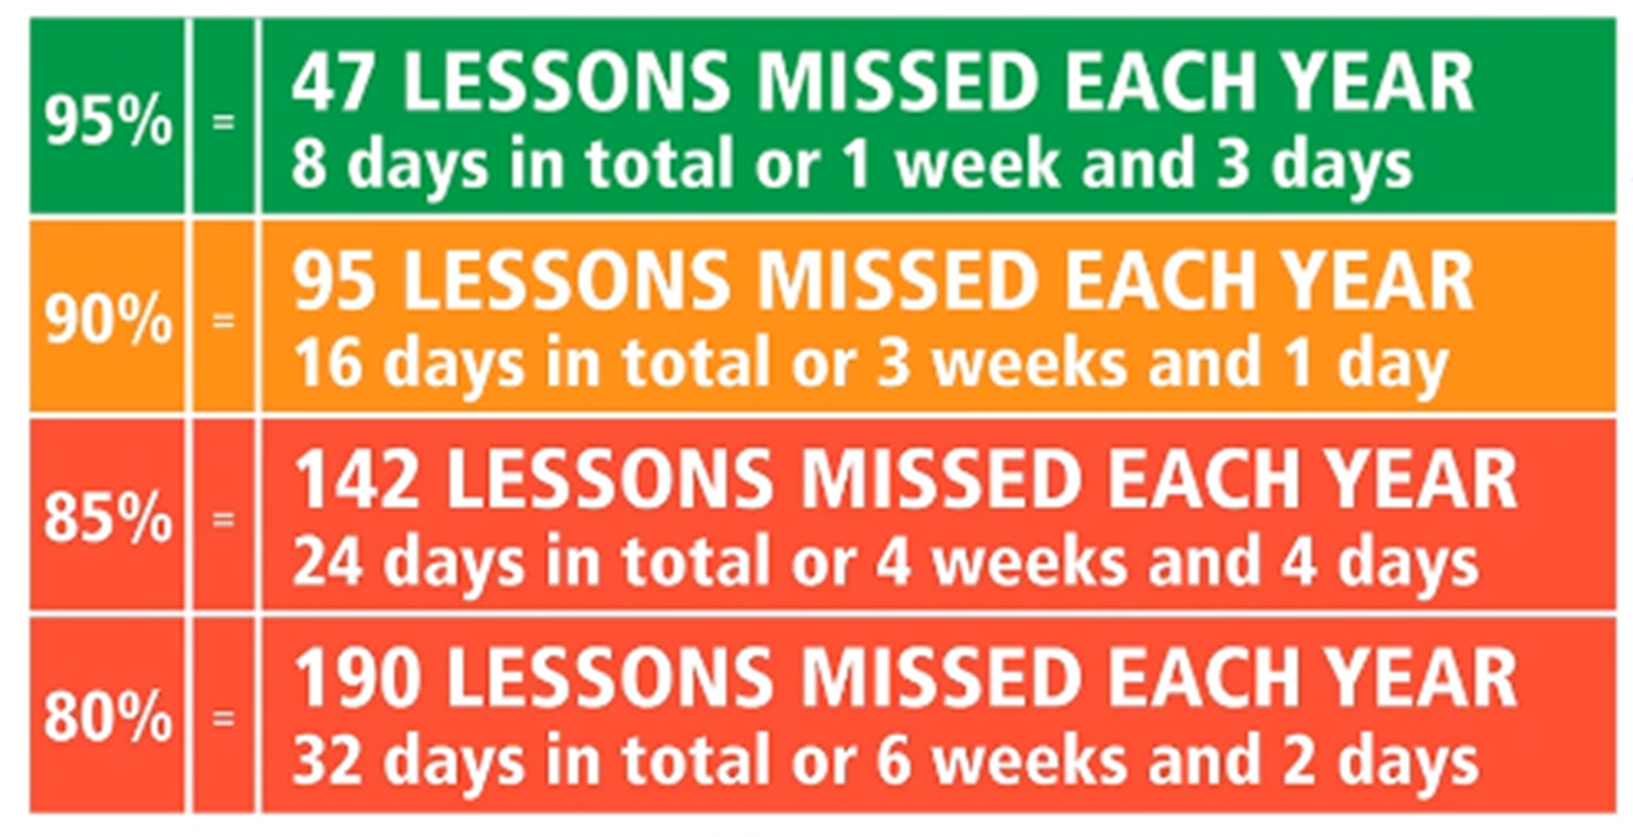
Every Day Attendance
Children arrive at school at 8:40, ready to come
into school at 8:45 when the gates will be closed.
Teachers take the register at 8:45.
Punctual arrival is important, as teaching starts promptly - aim for 100% attendance!
Did you know…?

Slide 4
Every Day Attendance
Please inform the School Office if your child is unwell on the morning of the illness (email or phone message).
Medication: avoid dosage in school if possible. Most 3x day dosages can be taken straight after school. Any prescribed or OTC medication brought in must be in the original packaging, in a named bag and handed in to the Office - there is a form to complete.
48 hours is needed before returning to school following diarrhoea and/or vomiting.
Term time absence, other than illness, is only authorised by the Head Teacher in exceptional circumstances - see Attendance Policy on the school website (currently being updated).

Slide 5
Asthma & Allergies
Please do not send in nuts or nut products (including Nutella type spreads) as part of snacks or packed lunches - we have a number of children and staff with life-threatening allergies.
Inhalers & spacers should be named and in a bag (for hygiene reasons). They are kept in a central place in class. An asthma card must be completed.
Epi-pens should be in date, in a named container and handed to the School Office with the protocol.
It is the parent/carer’s responsibility to ensure inhalers and auto-injectors are in date
and in school.
See our Medicines in School policy on the school website

Slide 6
Year 3 Essentials: Every Day
Water bottles should be brought into school
daily. Children can refill them in school as
needed and must take them home to clean
at the end of the day - water only please,
no squash, juice or fizzy drinks.
Clothing suitable for the weather and activities:
coat (hats & gloves in winter) and sensible shoes for outdoor playtimes (especially for Forest School).
Book bag: Reading book & Reading Record DAILY!

Slide 7
Year 3 Essentials: Every Day
Please do not bring in:
Show and tell items unless requested as part of a project or home learning task.
Pencil cases - all stationery is provided.
Toys, including collector cards.
Jewellery (small studs only for pierced ears).
KS2 -no sugary snacks, fizzy drinks or sweets - healthier snacks for break time please .

Slide 8
Year 3 Essentials: Every Day
Morley PE Kit
NO Jewellery.
White T-shirt
Navy shorts and joggers and sweatshirt,
Trainers or plimsolls.
NAMED PLEASE
Please take home to wash regularly.

Slide 9
KS2 Year 3 Essentials: PE kits
Our PE days are on: Monday and Thursday
Afternoon PE: children bring their PE kit into school to change into before the lesson, but may keep it on afterwards. This will then need to be returned to school the next day.
Notes:
KS2 page – KS1 delete

Slide 10
KS2 Year 3 Essentials: PE kits
Long hair must be tied back, so come prepared
with a hair band in kits.
Jewellery should not be worn in school.
Stud earrings will either need to be taken out or taped up for PE lessons. It is the children’s responsibility to organise this. School does not provide micropore tape.
KS2 children & parents will be informed about
swimming lesson arrangements.
Notes:
KS2 page – KS1 delete

Slide 11
Year 3 General
Letters and notices:
Most information will be via ParentMail.
Please sign up if you have not already done so.
Check the weekly newsletter for key information and the class page on the website for general year group information.
Birthdays:
No sweets please, if you want to send in something to share and celebrate, please consider something useful/enjoyable such as a small game book for the class. There is no requirement for this!

Slide 12
Year 3 Essentials: Helping at Home
At Morley Memorial Primary School we see home learning as an opportunity for children to practise skills, develop independence, consolidate and reinforce learning and as an avenue for children to pursue interests and be creative.
Home learning also provides unique opportunities for family learning and collaboration.
Please support your child to complete tasks in their own way in order that they develop our positive learning dispositions at home and at school:
Motivation Curiosity Courage
Collaboration Resilience Reflection

Slide 13
Year 3 Essentials: Helping at Home
We believe every child has the right to a childhood, opportunities to play and explore and time to develop their talents and interests. We therefore try to keep home learning to a level which allows an appropriate balance.
We will assign home learning where there will be benefits to children’s learning rather than to fulfill an expectation of a particular number of hours a week. This approach we believe promotes effective home learning with activities which are meaningful and increase children’s engagement and achievement.
Having said this, frequent (daily) reading and practice of number facts is crucial if children are to make good progress and develop key, basic skills.

Slide 14
Year 3 Essentials: Home Learning
In Year 3, our Home Learning tasks will always include:
Regular (daily) reading – remember the Reading Record book!
Spelling of keywords for our year group
Maths fluency practice
Notes:
KS1 page – KS2 delete

Slide 15
Year X Essentials: Home Learning
Home learning in KS2 often also includes tasks such as:
Independent research about a topic or aspect of
in-school learning
Creating artefacts, models or artwork related to topics being studied
Creating presentations or using JamBoards for group work
Learning new vocabulary for the topic, or related to Year Group word lists
Consolidation and revision activities based on what has been learnt in class.
Notes:
KS2 page - KS1 delete

Slide 16
Google Classroom & E-Safety
Home Learning information and tasks are
shared via Google Classroom.
In Year 3 Home learning will be shared on Friday to be returned by Thursday.
Google Classroom provides great opportunities for collaborative learning and the sharing of online information.
However, online activity presents its own challenges and issues. Please ensure children are supervised appropriately while working online, and that their interactions online are respectful of others and appropriate to the task.
If you, as a parent or carer, need to contact the teacher please email the school office in the usual way.
Please see the e-safety information on our school website:
www.morley.cambs.sch.uk/e-safety-for-parents/
Notes:
KS2 page – KS1 delete

Slide 17
Thank you for all your support!
Home/school communication is key
to children’s success: when children
know that all adults around them
are working together with the same
aims then they feel secure and are more
likely to succeed.
General questions?
For individual queries please contact the office
to make an appointment.

Slide 18
Finally - Links on the website:
Link to this presentation (by the end of the week)
Maths, Reading and Writing Age Related Expectations (Target Tracker)
Year 3 spelling list
Maths fluency practice information
Penpals cursive handwriting example
Long term curriculum plan
THANK YOU!

